Slide 1

Populations and population genetics/genomics
Today:
What is population genomics and what can it tell us?
What do we mean by a population?
What is DNA variation (in this context)
The four (five) forces
Tomorrow:
Genetic structure
SFS, FST
PCA
Admixture
Image credit: Samudrapom Dam (2023). Generated using DALL.E.3

Slide 2
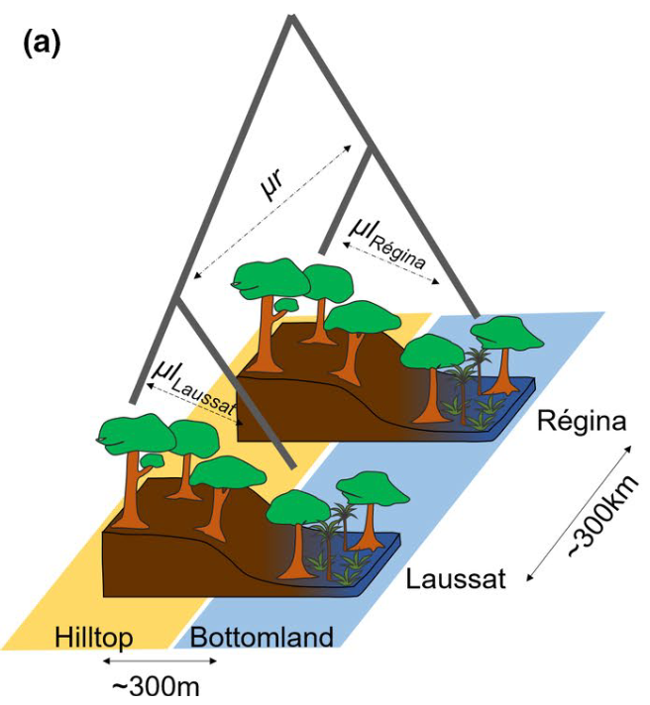
Populations and population genetics/genomics
Why pop gen? Recent, detailed changes in your study group.
Conservation genetics: How likely is my group to adapt to changing environments? Is my group inbred? Are there local subgroups within my group?
Species delimitation: Are there cryptic species within my group? Are two species actually one?
Demographic history: How has my group’s population size changed over time? When did the different subgroups split from each other? Has there been mixing with other groups?
Species identification: What is the smallest nr. of loci to identify my species for each sample? Combat illegal trade
Landscape genomics: Does my species vary with space? Environment? Geographic barriers?
Association studies: What genes underly which traits? E.g.: fruit size, flower colour, metabolite

Slide 3
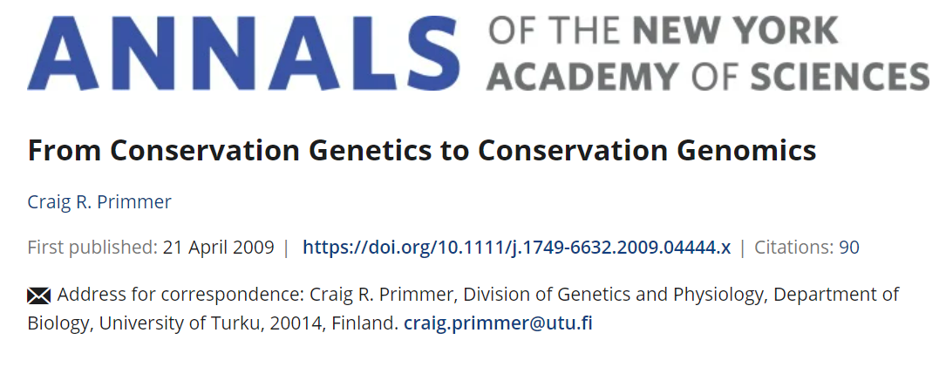
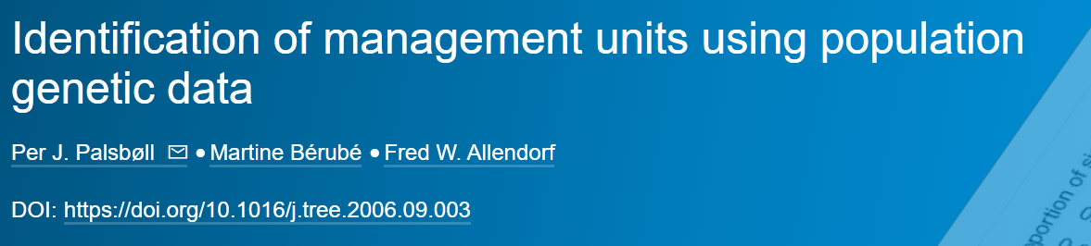
Populations and population genetics/genomics
Why pop gen? Recent, detailed changes in your study group.
Conservation genetics: How likely is my group to adapt to changing environments? Is my group inbred? Are there local subgroups within my group?
Notes:
per population are often needed to accurately estimate the genetic diversity using microsatellite‐based population genetic studies (Hale et al., 2012).

Slide 4
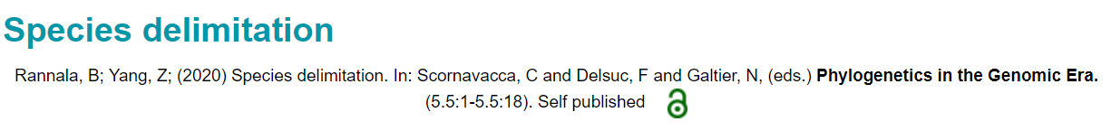
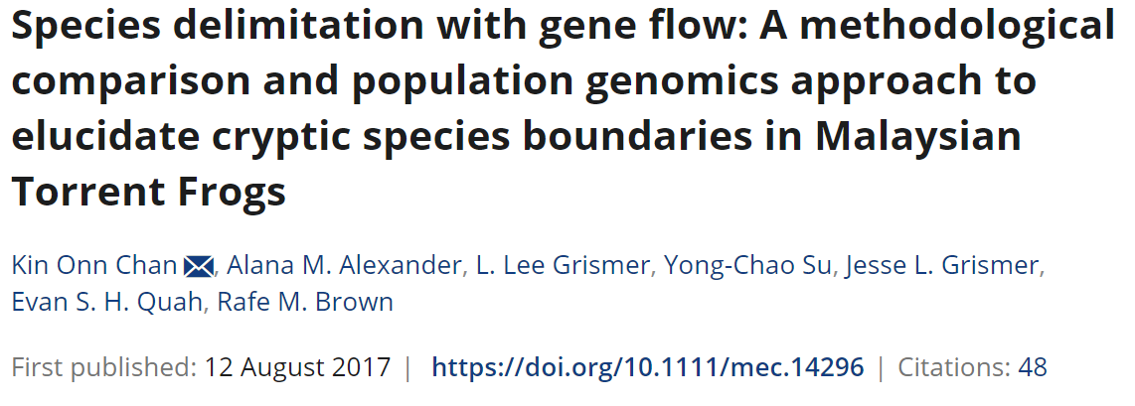
Populations and population genetics/genomics
Why pop gen? Recent, detailed changes in your study group.
Species delimitation: Are there cryptic species within my group? Are two species actually one?
Notes:
per population are often needed to accurately estimate the genetic diversity using microsatellite‐based population genetic studies (Hale et al., 2012).

Slide 5
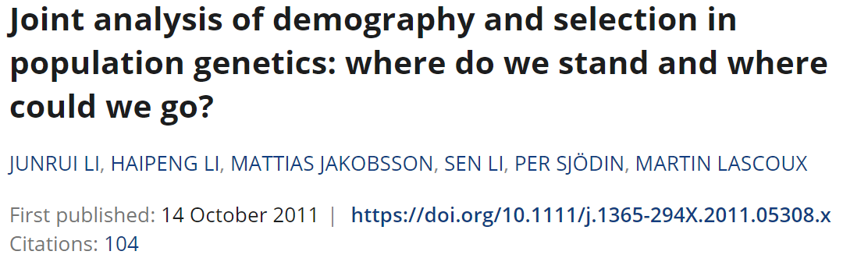
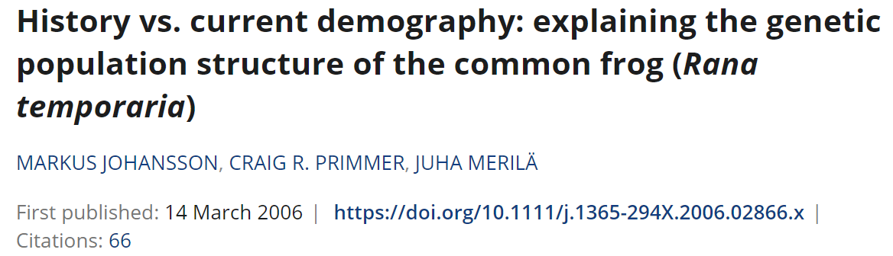
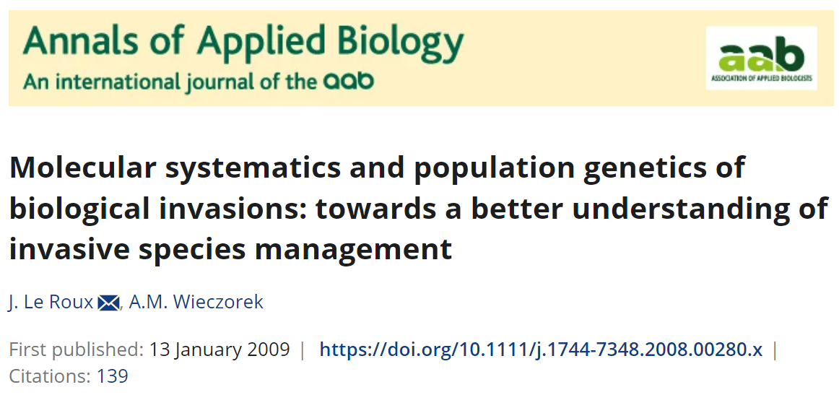
Populations and population genetics/genomics
Why pop gen? Recent, detailed changes in your study group.
Demographic history: How has my group’s population size changed over time? When did the different subgroups split from each other? Has there been mixing with other groups?
Selection vs demography
Notes:
per population are often needed to accurately estimate the genetic diversity using microsatellite‐based population genetic studies (Hale et al., 2012).

Slide 6
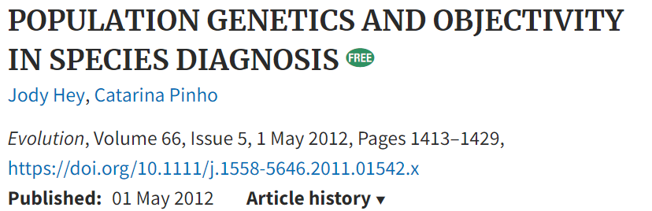
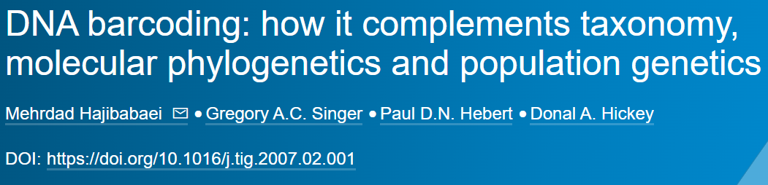
Populations and population genetics/genomics
Why pop gen? Recent, detailed changes in your study group.
Species identification: What is the smallest nr. of loci to identify my species for each sample? Combat illegal trade
Notes:
per population are often needed to accurately estimate the genetic diversity using microsatellite‐based population genetic studies (Hale et al., 2012).

Slide 7
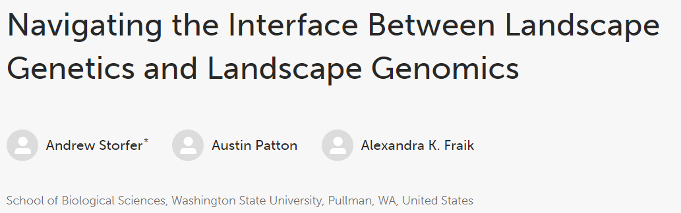
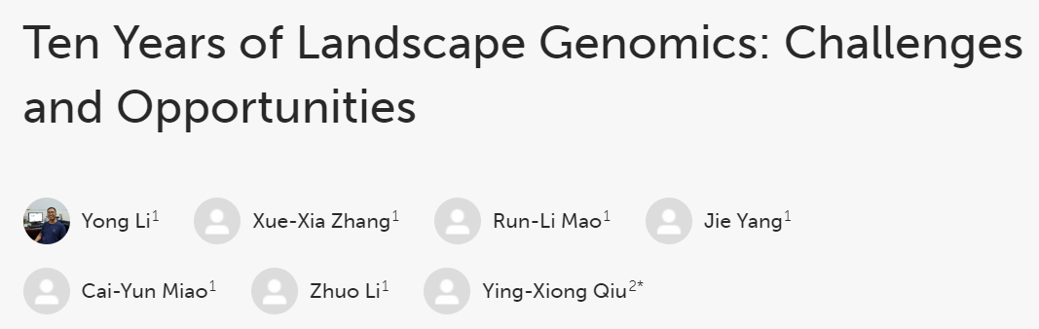
Populations and population genetics/genomics
Why pop gen? Recent, detailed changes in your study group.
Landscape genomics: Does my species vary with space? Environment? Geographic barriers?
2018
2017
Notes:
per population are often needed to accurately estimate the genetic diversity using microsatellite‐based population genetic studies (Hale et al., 2012).

Slide 8
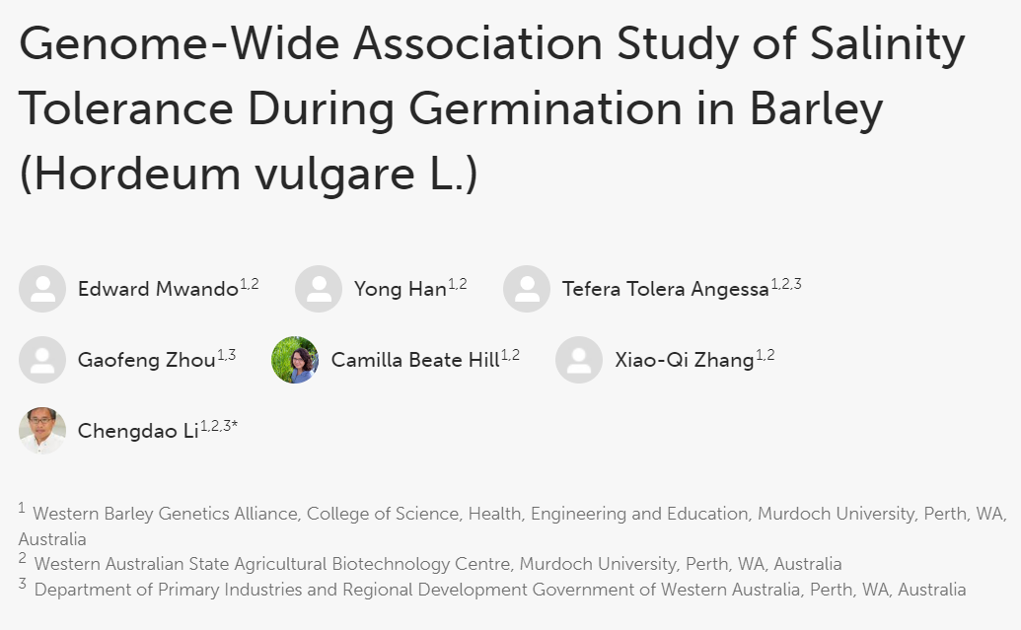
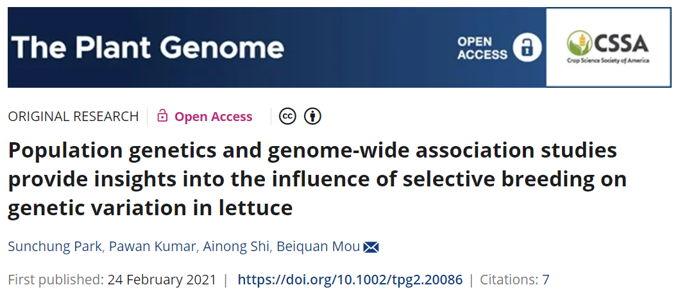
Populations and population genetics/genomics
Why pop gen? Recent, detailed changes in your study group.
Association studies: What genes underly which traits? E.g.: fruit size, flower colour, metabolite
2018
Notes:
per population are often needed to accurately estimate the genetic diversity using microsatellite‐based population genetic studies (Hale et al., 2012).

Slide 9
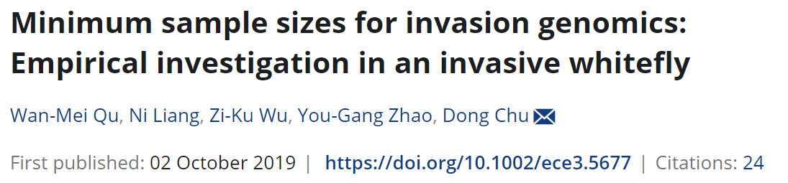
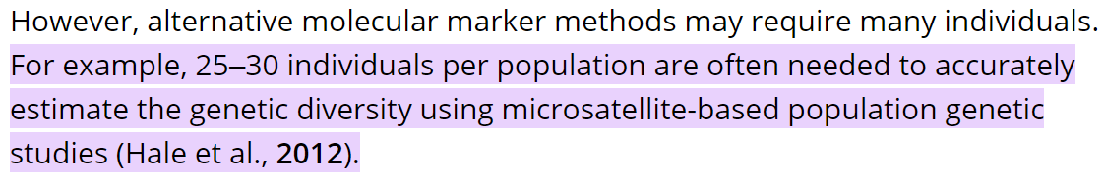
Populations and population genetics/genomics
More than one individuals per population
How many? As many as you can. Depends on your question.
The more closely related your group, the more you need
Minimum 20 for FST (population differentiation). Beacham et al. (2006) .
Notes:
per population are often needed to accurately estimate the genetic diversity using microsatellite‐based population genetic studies (Hale et al., 2012).

Slide 10
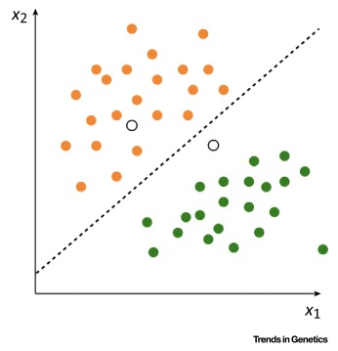
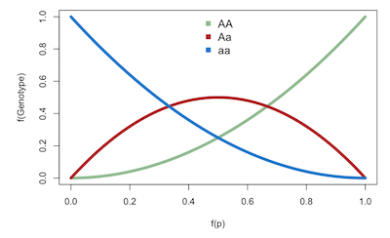
What is a population?
Group of individuals
from the same species…
that occupy the same geographic region…
at the same time…
Interbreeding…
Key attributes:
Allele and genotype diversity
Population size (Ne)
Structure
Supervised Machine Learning for Population Genetics: A New Paradigm
Unibaas (2020). Population Genetics - Simulations with R

Slide 11

What is population genetics?
A subfield of genomics that deals with:
Genetic composition of populations
Factors influencing genetic variation (drift, mutation, migration, selection)
Relationships among populations
Complex mathematical models
Image credit: J.P. Morgan Healthcare Conference (2020)
Notes:
Free resources below!
Population genetics is interested in understanding the genetic composition of populations of individuals belonging to the same species, and the factors influencing genetic variation such as mutation, migration, selection and genetic drift.
Indirectly it is also interested in the relationships among those populations of individuals.
You might be noticing a similarity with phylogenomics, in that we are interested in relationships among groups. There are two main differences:
Population genetic methods compares populations, not species.
And the comparison is usually quantitative, not qualitative. (it gives us a number we can compare).
This is not to say population genetics is superior – they are two related disciplines with different domains of application.
Pop gen methods work well below the species level, and phylogenetic methods above it.
MSC?
Discussion that avoids the math: https://plato.stanford.edu/entries/population-genetics/
Very mathy but main book: https://github.com/cooplab/popgen-notes

Slide 12
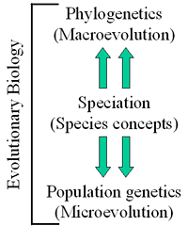
Population genetics vs. Phylogenetics
How is it different from phylogenetics in aims and techniques?
Populations, not species
Multiple individuals per population, not one
More quantitative, less qualitative
Population genetics:
Wants to understand: genetic variation, allele frequencies, evolutionary processes (4 forces), adaptation, genetic basis of traits
Phylogenetics:
Relationships, divergence times, ancestral states
Bruce A. McDonald. Population Genetics of Plant Pathogens.

Slide 13
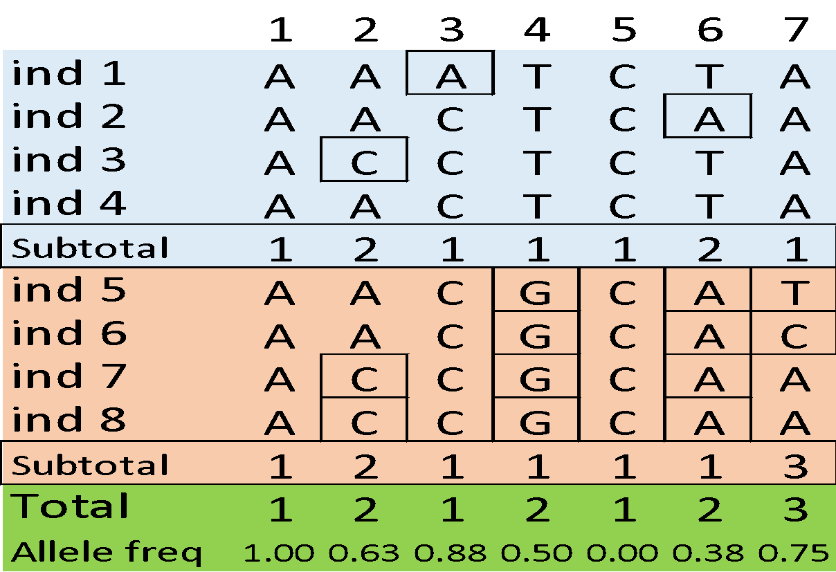
So, what is variation?
The basis of everything!
Non-variable (monomorphic) site
Variable (polymorphic) site
Singleton

Slide 14
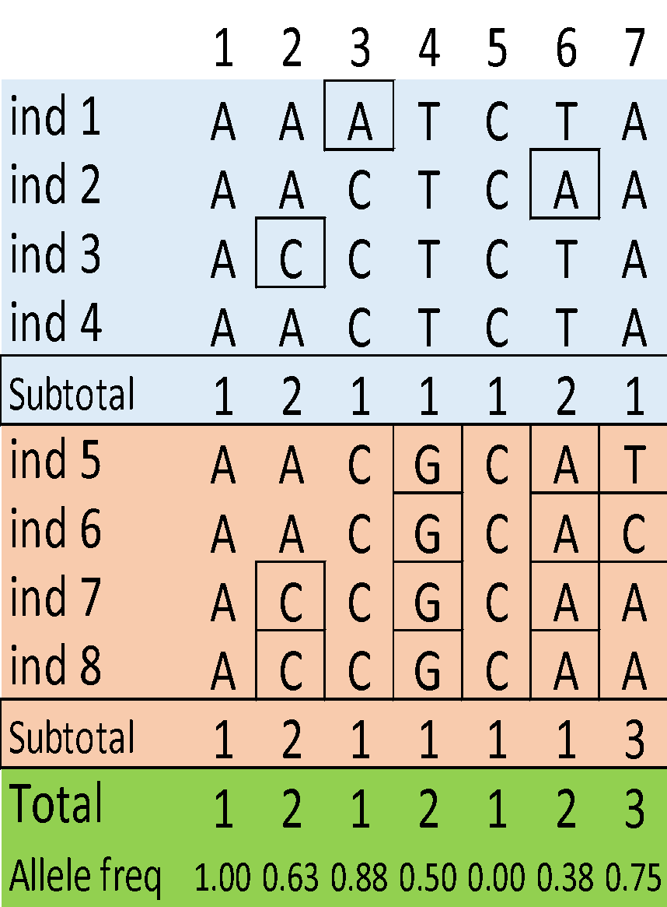
So, what is variation?
The basis of everything!
Non-variable (monomorphic) site
Variable (polymorphic) site
Singleton
Fixed difference
Partially differentiated site
Tri-allelic site
?

Slide 15
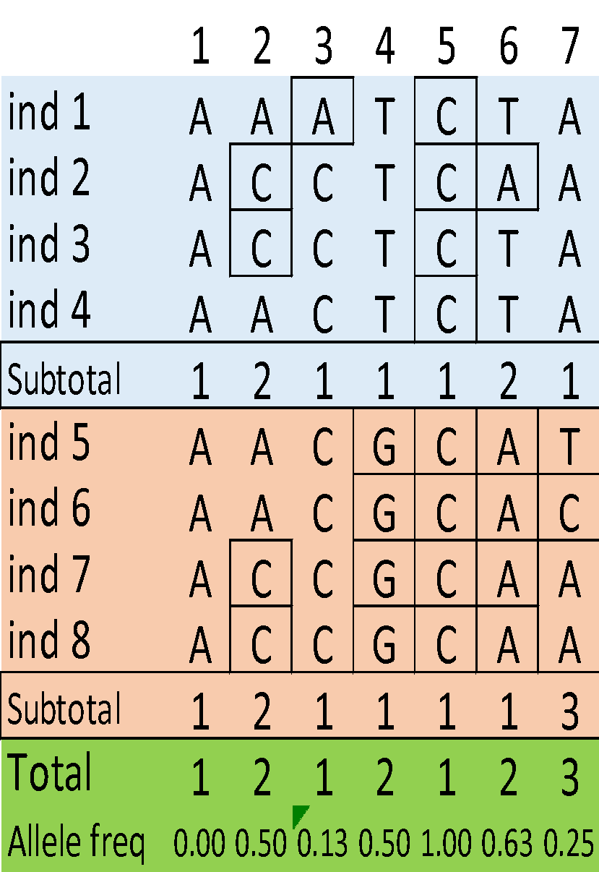
So, what is variation?
Derived allele
The basis of everything!
Non-variable (monomorphic) site
Variable (polymorphic) site
Singleton
Fixed difference
Partially differentiated site
Tri-allelic site
?

Slide 16
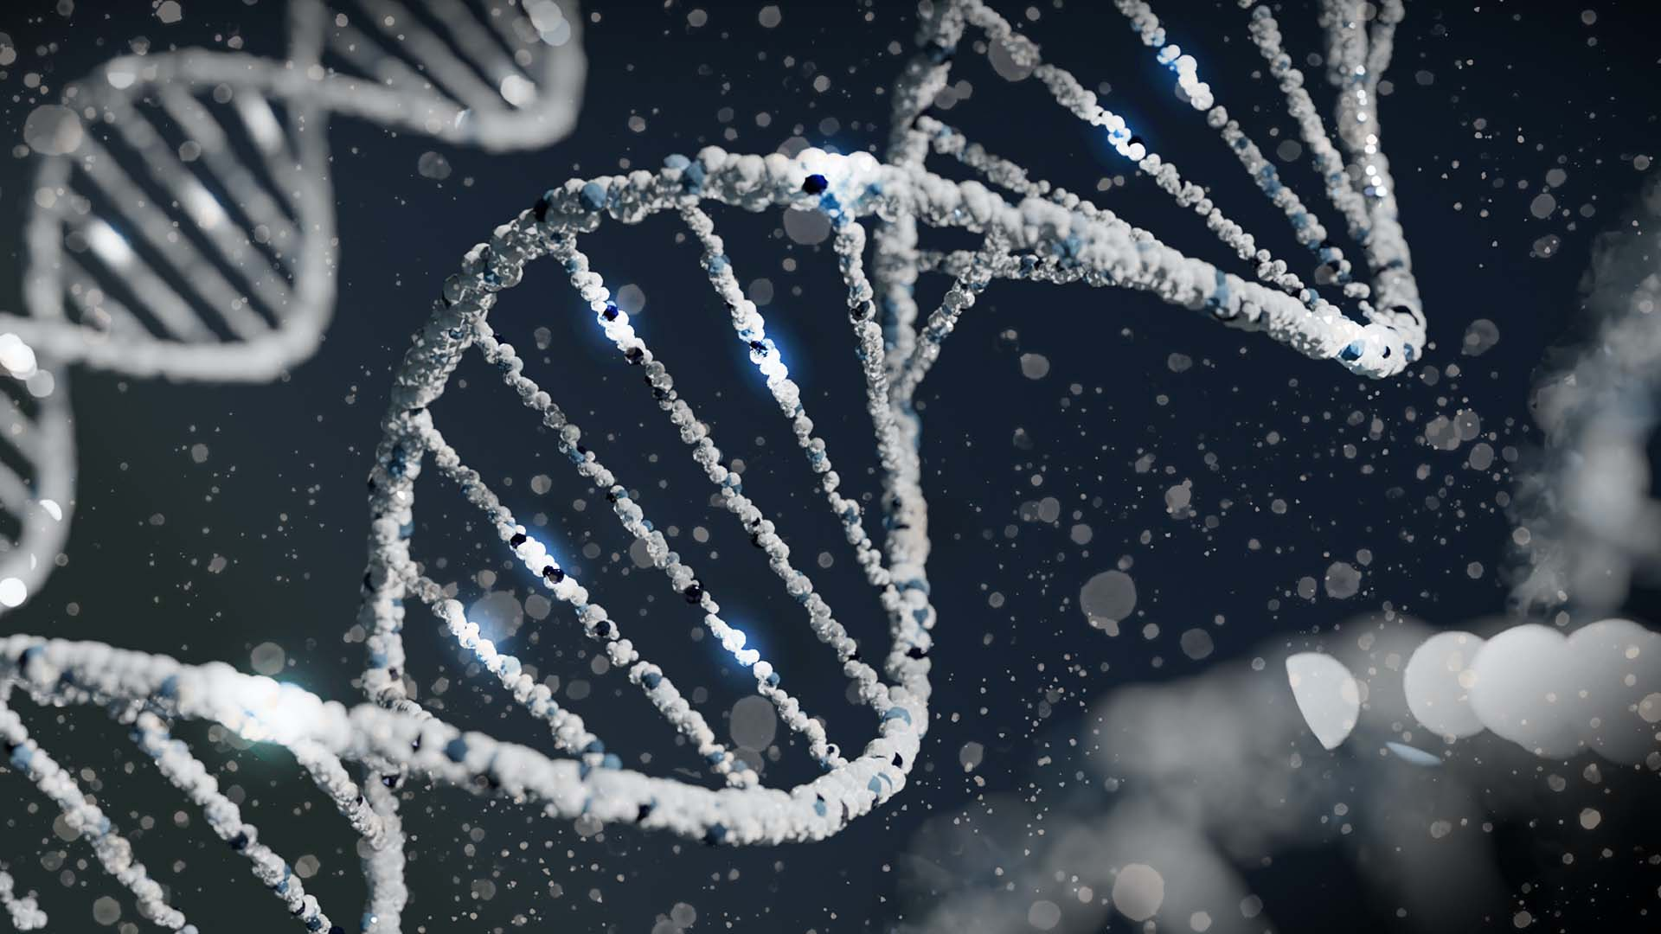
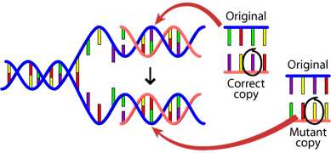
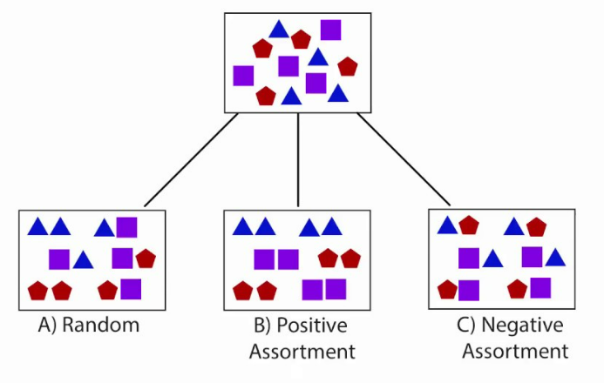
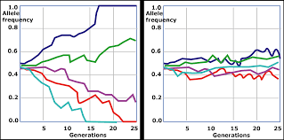
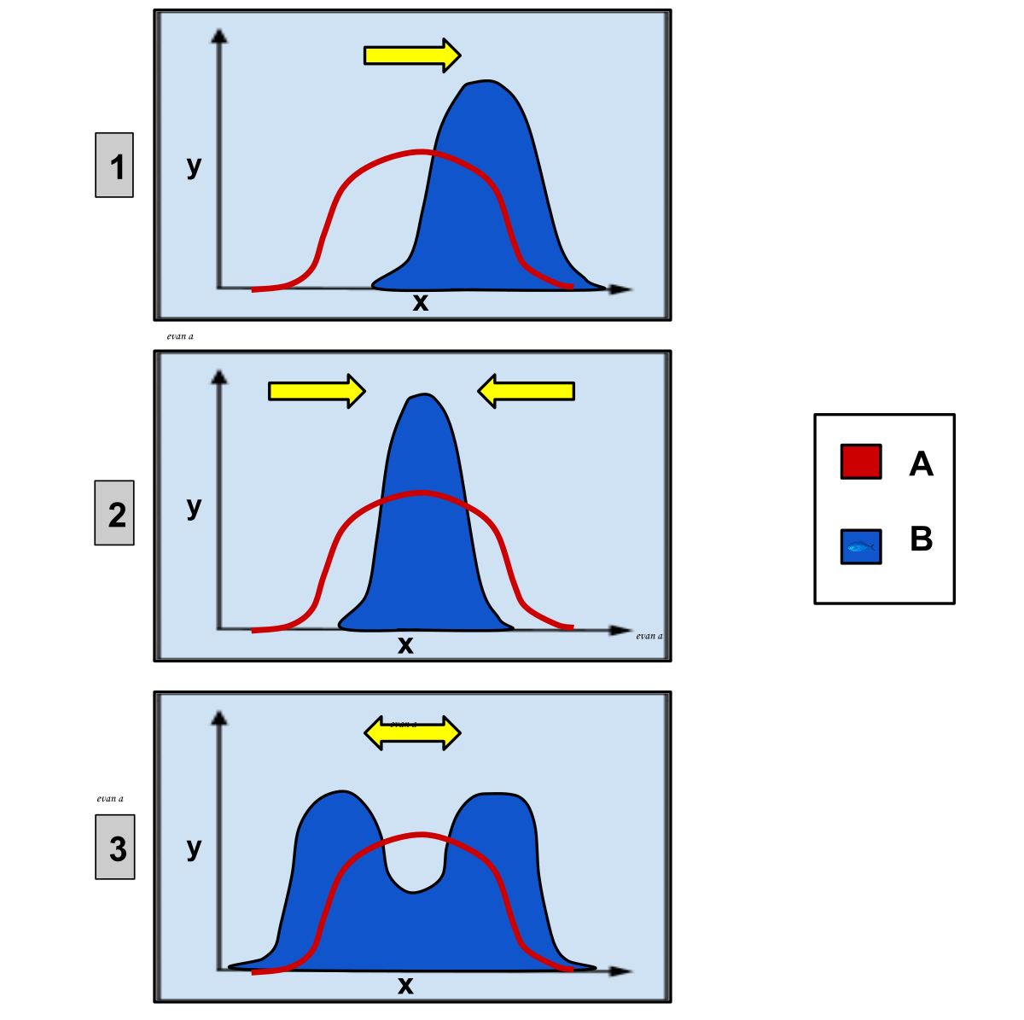
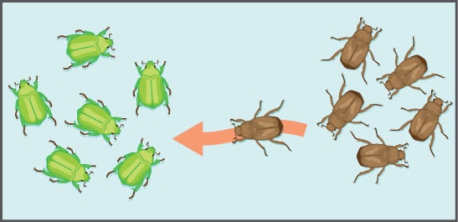
Forces that affect genetic composition
Image credit: Sangharsh Lohakare (@sangharsh_l) on Unsplash.
Mutation
(Non-random mating)
Genetic drift
Allele frequencies!
Selection
Migration
Image credit: Population genetics. Openstax.org

Slide 17
Mutation
The ultimate source of variation
Arises through DNA replication errors
Introduces new alleles into a population
Can be neutral, deleterious or beneficial
Mutation rate is very low: 1 in 10⁸ per generation,
Genome size: 3 x 10⁹
~ 30 nucleotide mutations each generation.
Image Credit: socratic.org

Slide 18
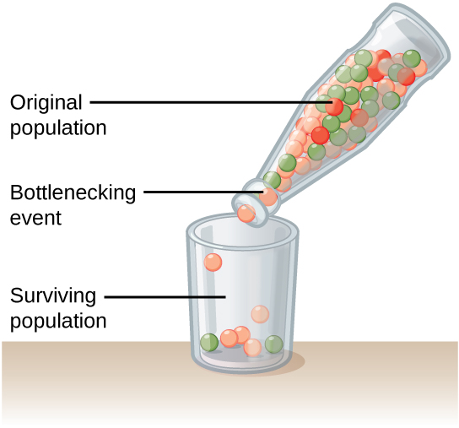
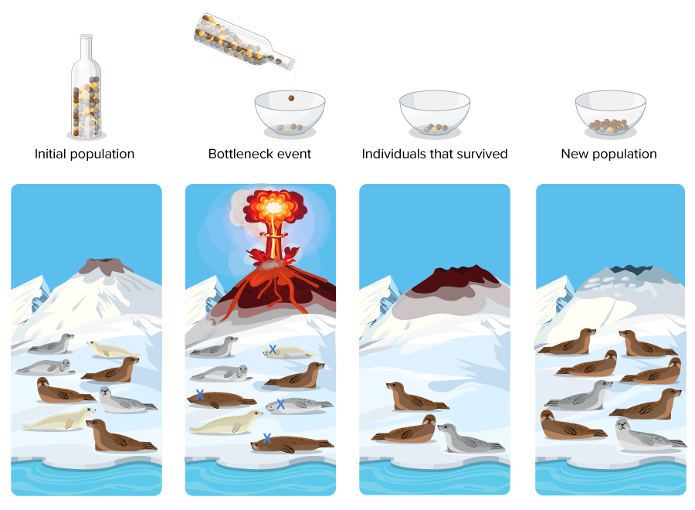
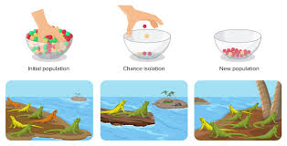

Genetic Drift
killowen.com/genetics3D
Random fluctuations of allele frequencies due to chance
Affects smaller populations more
Can occur through:
Population bottleneck
Founder effect
Diversity depleting force
Credit: Clark, Openstax.org
Good non math explanations with a quiz! at the end: https://www.biologyonline.com/dictionary/genetic-drift
Douglas Wilkin (2022). 5.20 Forces of Evolution
Douglas Wilkin (2022). 5.20 Forces of Evolution
Notes:
Good non math explanations with a quiz at the end: https://www.biologyonline.com/dictionary/genetic-drift

Slide 19
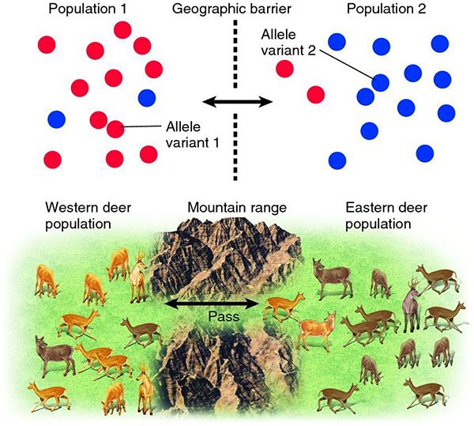
Migration
Causes introduction of new alleles or allele frequency shifts
Tends to homogenise allele frequencies among populations
Diversity promoting or diversity purging
Image credit: BIL 160 - Lecture 6
Notes:
Diversity promoting or diversity purging? Both

Slide 20
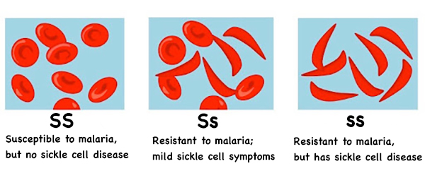
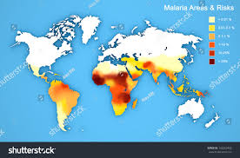
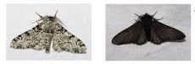
Selection
It acts by favouring some alleles over others
Can lead to fixation (p=1.0) of advantageous alleles…
or elimination of deleterious alleles (p=0)
3 types:
Directional
Stabilizing
Disruptive
Image Credit: Biology Roots. Population Genetics and Hardy Weinberg Presentation
Image Credit: Wikipedia

Slide 21
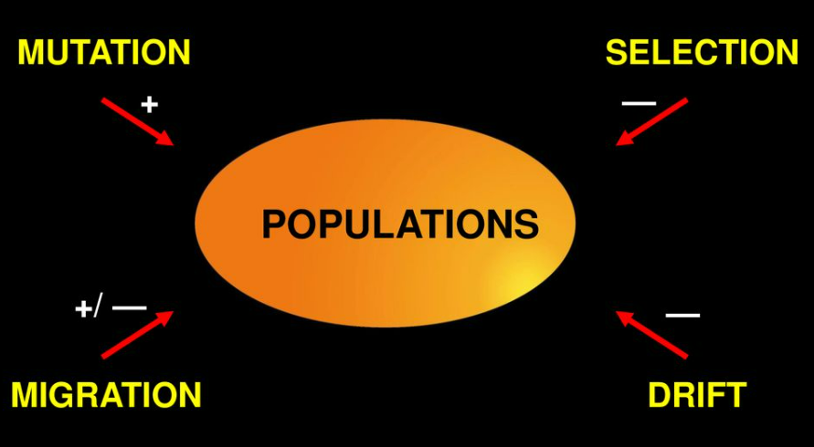
Recap of the four forces
Richard Morrison, 2019: Populations mutation selection drift migration + — +/ — —

Slide 22
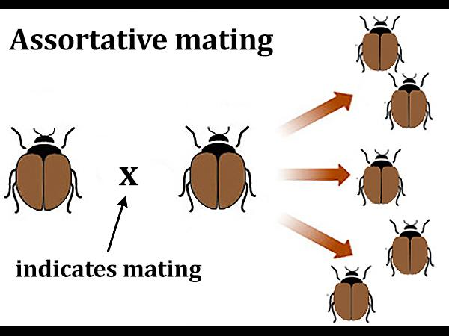
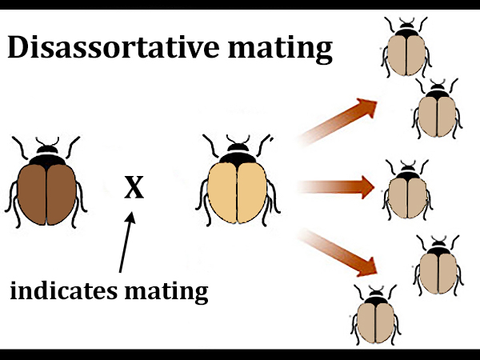
Non-random mating
Preference of individuals to mate with certain partners based on specific traits
Geographic proximity, behavioural traits
Assortative: Tendency to mate with individuals with same allele
Disassortative: (…) with a different allele
A mechanistic model of assortative mating in a hybrid population
Image credit: BIL 160 - Lecture 6
Notes:
Think:
Would this force be diversity promoting or diversity purging?
To know more: https://www.bio.miami.edu/dana/160/160S22_8.html

Slide 23
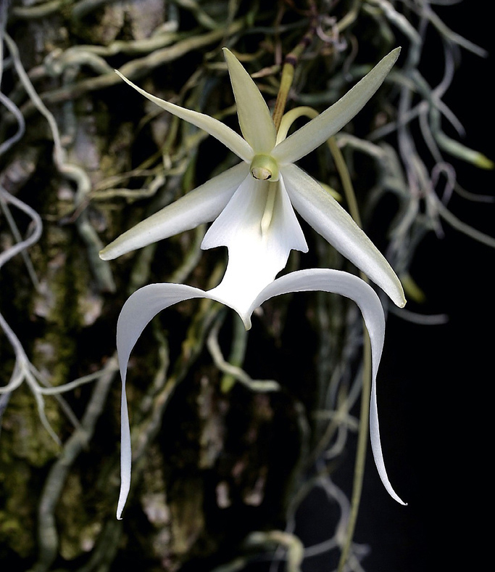
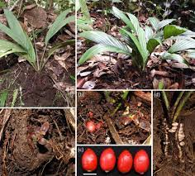
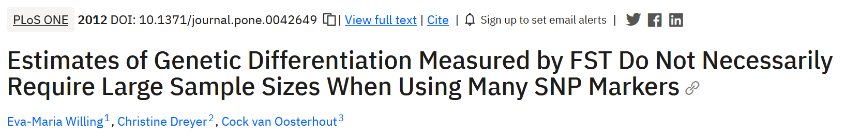
Pop gen with few individuals
Acknowledge limitations:
reduced statistical power
spurious results
find only the strongest effects
Combine methods and narrow down questions.
Targeted genotyping: target genes that really matter
Pedigree analysis allows stronger inferences as it knows ancestry
Population modelling can sometimes work with fewer data
Comparative analysis with a larger population
Dendrophylax lindenii. https://novataxa.blogspot.com/
Pinanga subterranea. https://novataxa.blogspot.com/

Slide 24
Paleomix flowchart
.fastq
.bam
Specify path
Index the reference
Trim adapters
Trim low Q bp
Filter short reads
Align reads to reference
Algorithm (mem, aln..)
Indexing bams
Validate format
Statistics (*.summary
Referenc
Trimming
Mapping
Bam validation
Checking directory &
Samtools
Adapterremoval
bwa
Picard & Samtools
Documentation: https://paleomix.readthedocs.io/en/stable/bam_pipeline/usage.html

Slide 25
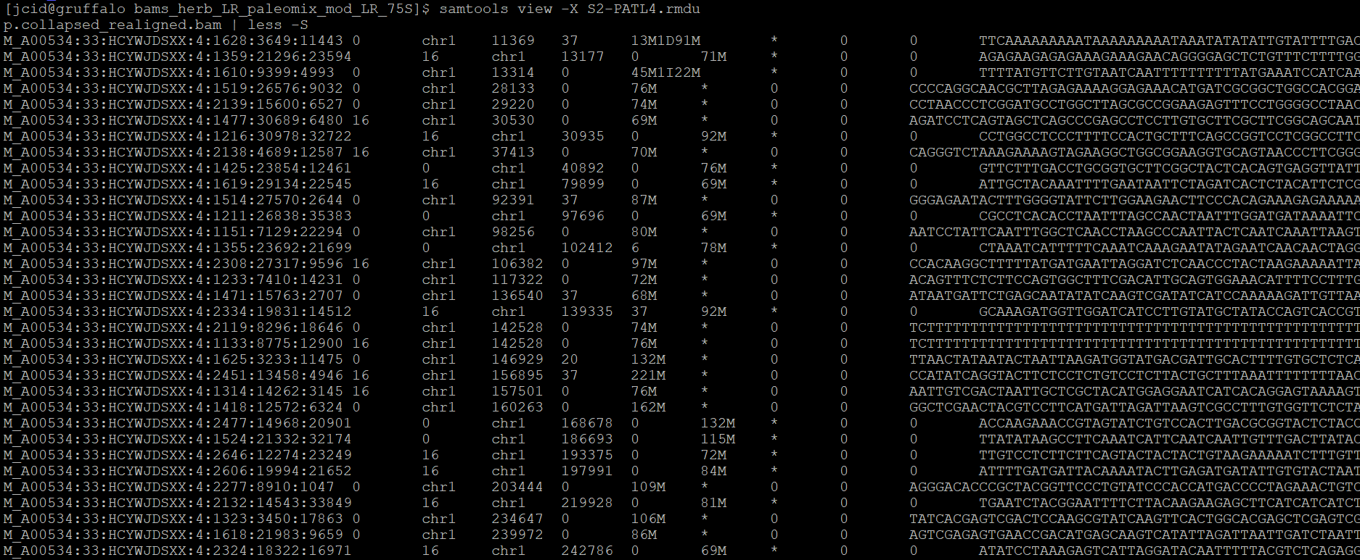
Example SAM file (command)
samtools view S2-PATL4.rmdup.collapsed_realigned.bam | less -S
Explanation of columns: https://en.wikipedia.org/wiki/SAM_(file_format)#:~:text=The%20SAM%20format%20consists%20of,edited%20with%20the%20software%20SAMtools.

Slide 26

After bams - deciding on the true nucleotide
Deciding, for each site, which nucleotide is the “true” one.
Three ways:
Variant calling: Most commonly used
Genotype likelihoods: with lower quality data
Pseudohaplotypes: even lower, lose all quality information
All of them can be used with angsd:

Slide 27
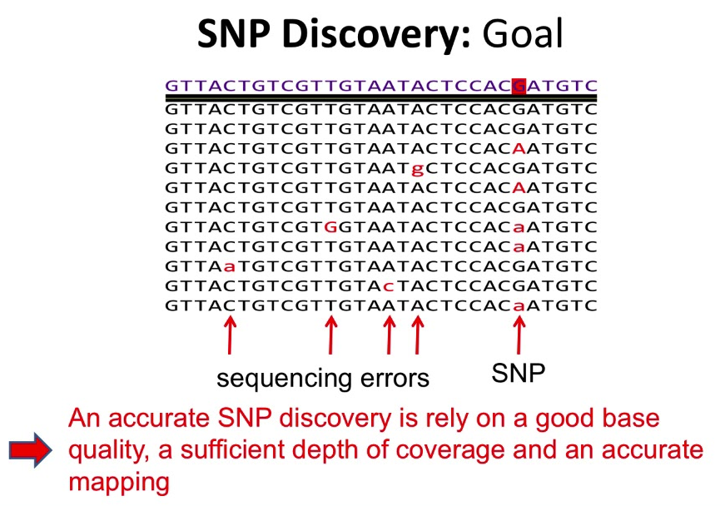
Variant calling
Decides what is the right nucleotide based on:
The sequencing quality
The mapping quality
The reference base
The sequencing depth
The number of nucleotides of each type visible
Gives the (most probable) base with respect to the reference base (0/1).
Mathieu Bourgey (2018). High-Throughput Sequencing Data 2018 workshop

Slide 28
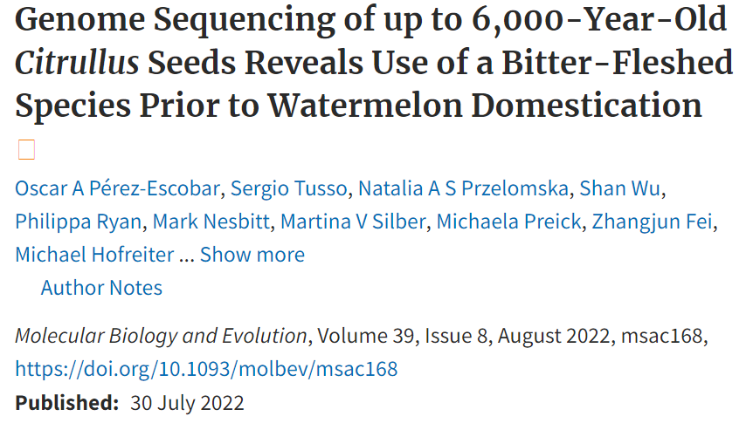
Pseudohaplotypes
From among all reads covering that site, choose a nucleotide.
How? For the moment, either:
Majority nucleotide
Random nucleotide
Loses all site quality information further on (no more filtering beyond)
However can still filter from the input bam with the command.

Slide 29
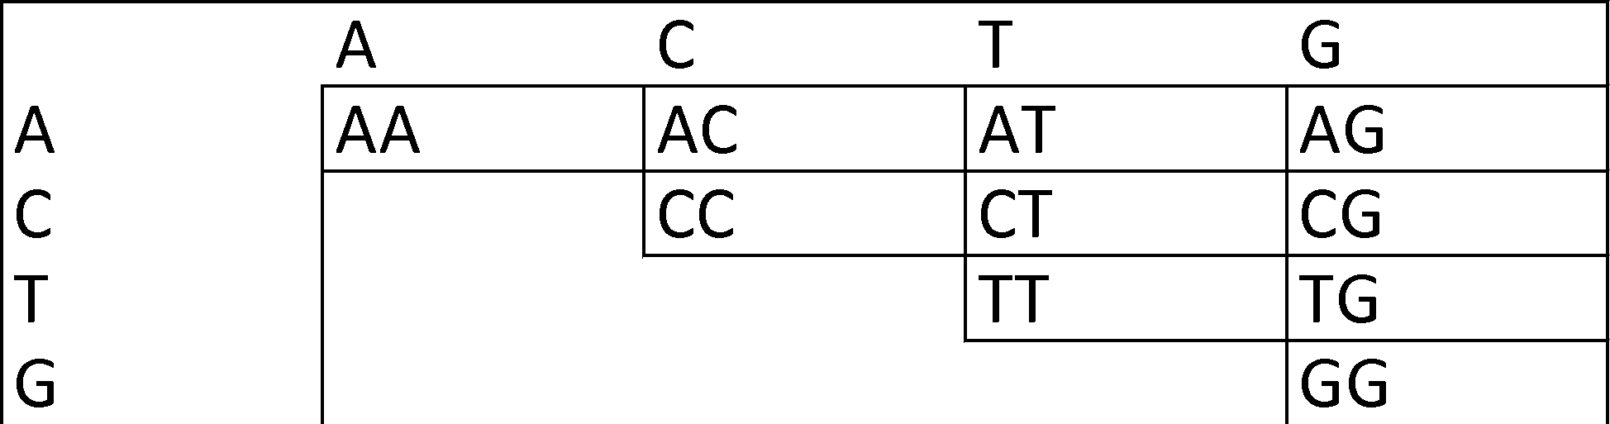
Genotype likelihoods
Instead of calculating the right nucleotide, gives the likelihood for all 10 genotypes (both nucleotides).
Allows better filtering further on (keeping only high lik. genotypes)

Slide 30
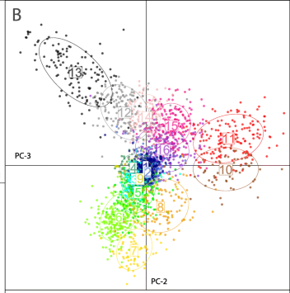
Population structure (subdivision)
The way genetic variation is distributed within and among populations.
Quantify the degree of genetic differentiation among populations.
Population structure = population differentiation = differences in allele frequencies
Tells us information about gene flow, potential for local adaptation, and conservation risk.
Kaya et al. (2021). Population genetic structure of Hermetia illucens
Notes:
One of the main concepts that population genetics is concerned about is population structure.
How genetic diversity or variation is distributed within and among populations.
It reflects the degree to which individuals within a population are related to one another compared to individuals in other populations.

Slide 31
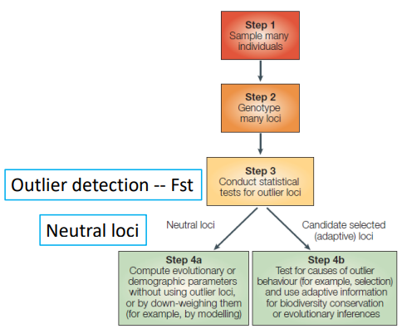
FST (fixation index)
Measure of genetic differentiation
John Wang (2020). Population Genetics
Notes:
Source:
https://introtogenomics.readthedocs.io/en/latest/_downloads/dcb0a7b4fbbda891b41940aec36d997e/Week8-popGenomics.JohnWang2020.pdf

Slide 32
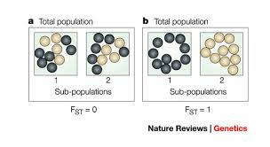
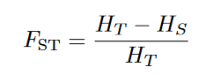
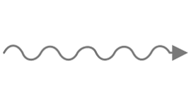


FST (fixation index)
John Wang (2020). Population Genetics
It measures the degree of genetic variation between subpopulations relative to the total genetic variation in the entire population.
HT is the total genetic variance in the entire population.
HS is the average genetic variance within subpopulations.
FST ranges from 0 to 1, where:
0 indicates no genetic differentiation between subpopulations (all subpopulations are identical).
1 indicates complete genetic differentiation (subpopulations are completely isolated and have no gene flow).
Graham Coop (2022) Population genetic notes
Notes:
In plants: 0.05 = insignificant, 0.15 = substantial differentiation
1 means no genetic diversity is shared between populations
https://en.wikipedia.org/wiki/Fixation_index

Slide 33
Basic command
https://www.popgen.dk/angsd/index.php/Fst
../angsd -b list1 -anc hg19ancNoChr.fa -out pop1 -dosaf 1 -gl 1
../angsd -b list2 -anc hg19ancNoChr.fa -out pop2 -dosaf 1 -gl 1
./realSFS fst index [saf.idx's] -whichFst 1
Notes:
https://bio.research.ucsc.edu/~barrylab/classes/evolushun/Pop_Gen_Summary.html

Slide 34

SFS (site frequency spectrum)
Describes the distribution of genetic variants within a population.
Count the number of segregating sites that are present at different allele frequencies across the population sample.
Evolutionary history and demographic processes of populations.
Great explanation: https://theg-cat.com/ tag/site-frequency-spectrum/
theg-cat.com/
Notes:
Provides insights into the evolutionary history
and demographic processes of populations.

Slide 35

SFS (site frequency spectrum)
Quick example:
Wikipedia
Notes:
Provides insights into the evolutionary history
and demographic processes of populations.
https://en.wikipedia.org/wiki/Allele_frequency_spectrum

Slide 36

SFS - reminder

Slide 37

Command solution
Tutorial for FST and SFS.
https://evomics.org/learning/population-and-speciation-genomics/2018-population-and-speciation-genomics/angsd-activity-sfs-fst-pbs/

Slide 38
SFS (site frequency spectrum)
Angsd: https://www.popgen.dk/angsd/index.php/RealSFS
./angsd [options] -doSaf .
./realSFS afile.saf.idx

Slide 39

Principal components analysis (PCA)
Useful when we have many variables, as we do in genomics (10⁹ bp).
Two problems:
Collinear variables. Why might variables in our dataset be collinear?
Overfitting to our particular dataset, with no possibility to extrapolate to other datasets.
So drop variables, but which? Also, lost information
Notes:
Useful when we have many variables, as we do in genomics.
Two problems:
Collinear variables. Why might variables in our dataset be collinear?
Overfitting to our particular dataset, with no possibility to extrapolate to other datasets.
So drop variables, but which? Also, lost information
PCAs solution is to convert variables into new features, axes, combination of the variables, and order them by the ones that explain more variability in the dataset

Slide 40
PCA – how does it work?
Project your samples onto a series of axes, made of a linear combination of allele (or genotypic) values across SNPs (variants)
Axes chosen so projection of samples along first explains greatest variance across axes.
The next axis maximizes the variance for all possible axes perpendicular to the first, and so on.
Typically 2 or 3 PC are presented.
Speed, identify structure due to various processes, and quick visual manner.

Slide 41

Novembre et al. (2009). Genes mirror geography within Europe

Slide 42


Slide 43


Gros Balthazard et al.(2021). Systematics and evolution of genus Phoenix

Slide 44

What is missing in this PCA?
Image Credit: Mina Nashed. Biorender

Slide 45
Pros and cons
1. Eradication of correlated features
2. Speed
3. Reduces overfitting
4. Improves visualization
1. Very sensitive to number of individuals per group
2. Loss of Information
Notes:
3. Reduces overfitting: Overfitting mainly occurs when there are too many variables in the dataset. So PCA helps in overcoming the overfitting issue by reducing the numbe
2. Loss of Information: Although principal components try to cover the maximum variance among the features in a dataset, if we don’t select the number of principal components with care, it may miss some information as compared to the original list of features.

Slide 46

Preliminary data – please do not share!
Notes:
PC3 and PC4

Slide 47
To know more
McVean (2009). A Genealogical Interpretation of Principal Components Analysis
A gentle introduction to PCA
Mathematical explanation
Notes:
McVean (2009). A Genealogical Interpretation of Principal Components Analysis https://www.ncbi.nlm.nih.gov/pmc/articles/PMC2757795/
Mathematical explanation: https://fritz.ai/understanding-the-mathematics-behind-principal-component-analysis/
A gentle introduction to PCA: https://medium.com/swlh/a-gentle-introduction-into-the-application-of-principal-component-analysis-pca-in-genomics-269026453295
Softwares: PCAngsd for genotype likelihoods.

Slide 48



Admixture (Structure)
Genetic ancestry: proportion of an individual's genetic makeup that can be attributed to different ancestral populations
When individuals or populations have mixed ancestry, their genetic profiles reflect a combination of genetic variation inherited from multiple ancestral populations.
Botigue et al. (2017). Ancient European dog genomes reveal continuity since the Early Neolithic
Notes:
builds on the concept of ancestral populations and admixture.
Ancestral Populations: NGSadmix assumes the existence of a set number (K) of ancestral populations that contributed genetically to the present-day individuals being analyzed. These ancestral populations represent distinct genetic groups in the past.
Admixture: Individuals are considered to be a mixture of these ancestral populations. Their genomes reflect varying proportions of genetic material inherited from each ancestral group.
Statistical Modeling: NGSadmix employs a statistical model to estimate these admixture proportions for each individual. It uses genotype likelihoods, which capture the probability of observing a particular genotype at a specific location in the genome. This accounts for the inherent uncertainty in NGS data.

Slide 49



Admixture (Structure)
Original NGSAdmix paper
Studies the genetic ancestry and population structure in populations.
It seeks to understand the extent to which different populations have contributed to the genetic makeup of individuals or groups
Particularly interesting where there has been historical migration, interbreeding, or population mixing.
https://www.popgen.dk/software/index.php/EvalAdmix
Notes:
Here's how the model works:
The model assumes that each individual's genotype at a specific locus (position on a chromosome) is a combination of alleles (genetic variations) from the ancestral populations.
It calculates the likelihood of observing the individual's genotype given the proposed admixture proportions and the allele frequencies in the ancestral populations.
The model iteratively refines the admixture proportions for each individual to maximize the overall likelihood of observing the genotypes across all individuals and loci.

